Slide 1
Using the Inclusive Design Principles
DCDC @LeonieWatson

Slide 2
Inclusive design
Is about designing for people with permanent, temporary, situational, and changing disabilities - all of us really

Slide 3
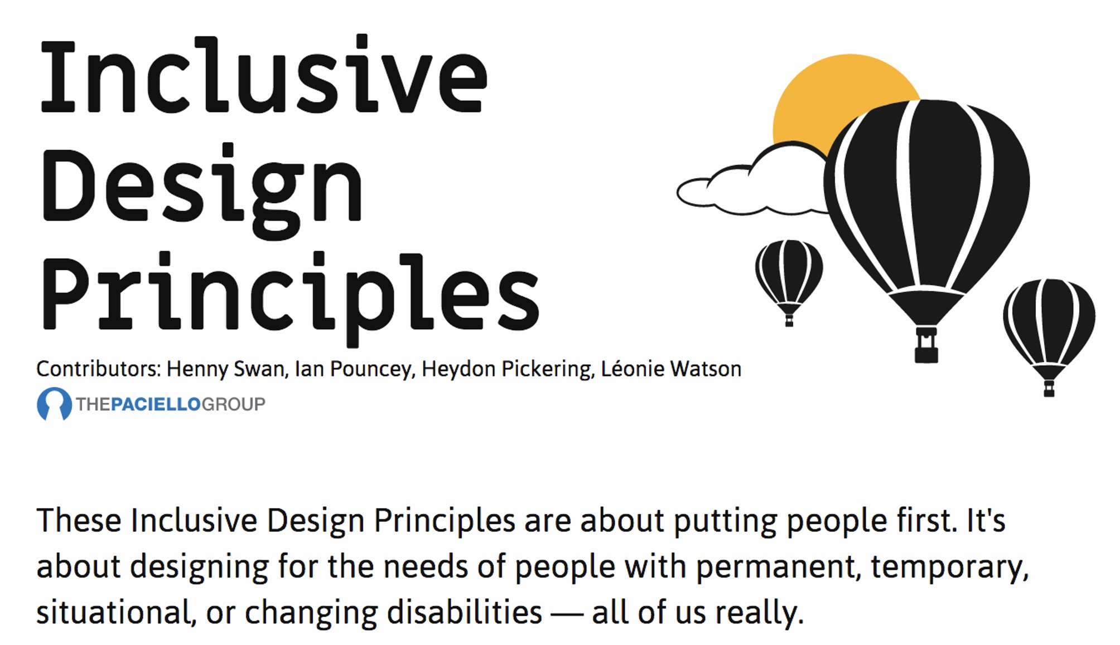
Inclusive Design Principles
InclusiveDesignPrinciples.org

Slide 4
Provide comparable experience
Ensure your interface provides a comparable experience for all so people can accomplish tasks in a way that suits their needs without undermining the quality of the content

Slide 5
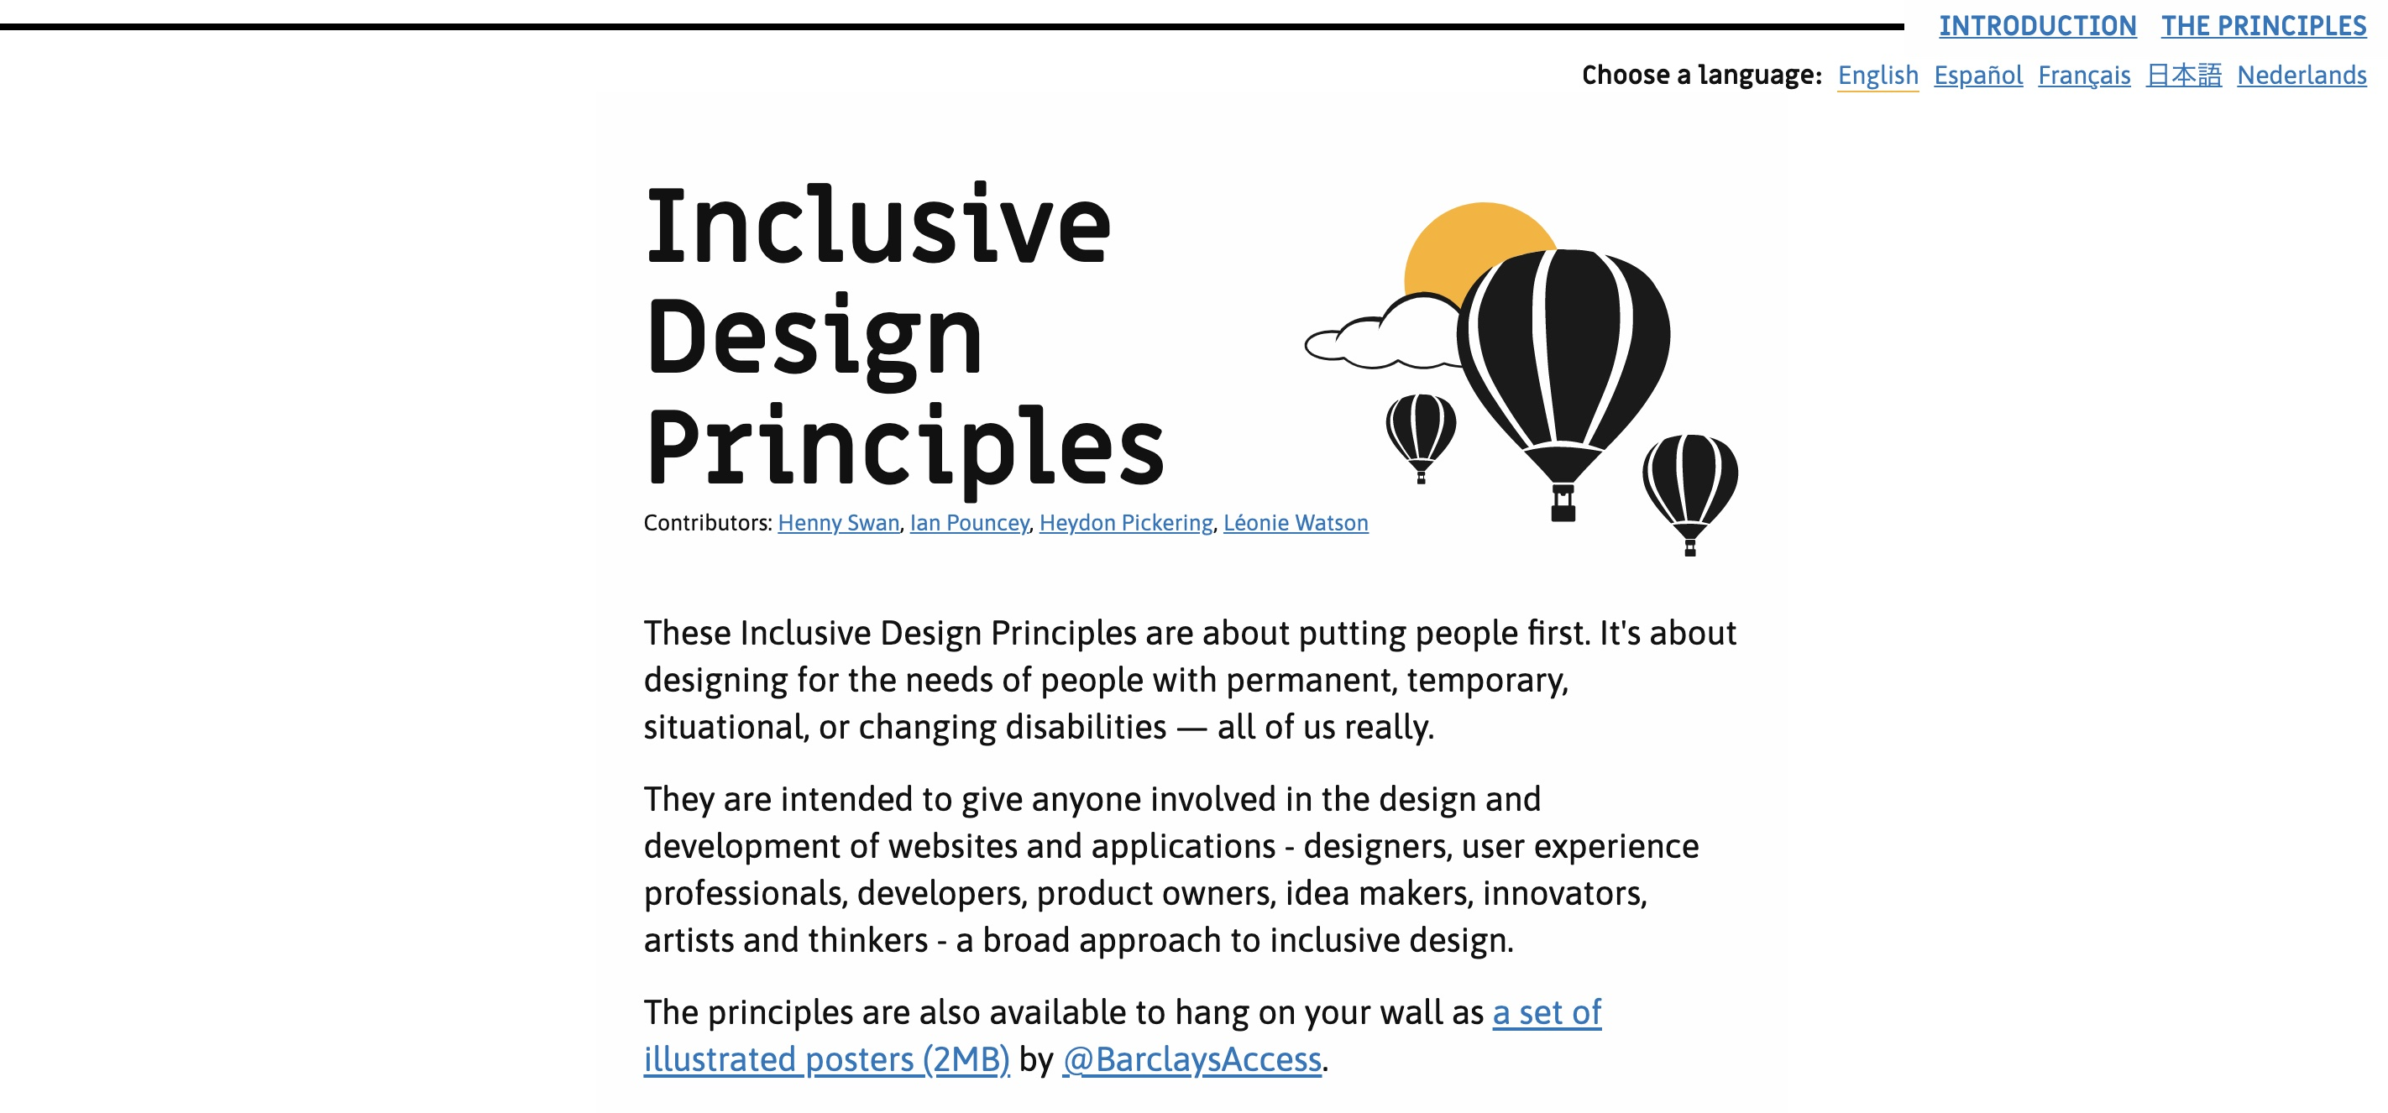
Image descriptions
Notes:
Emotion rich images are images that could be considered decorative but can also provide an emotional connection to a website or application.
If used thoughtfully, text descriptions for emotion rich images are a way to convey the look, feel and personality of your website or application.
The hot air balloon image on the Inclusive Design Principles homepage is an emotion rich image.

Slide 6
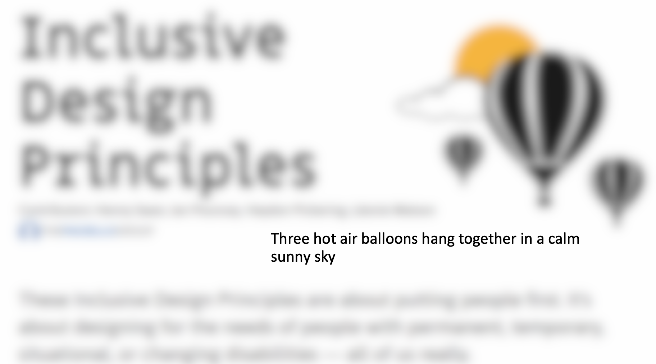
Image descriptions
Notes:
The text description for the image is “Three hot air balloons hang together in a calm, sunny sky”. While it is not essential information, it adds personality to the page. Some blind people appreciate the added context.

Slide 7
Consider situation
People use your interface in different situations. Make sure your interface delivers a valuable experience to people regardless of their circumstances

Slide 8

Colour contrast
Notes:
Photo credit: Credit: Getty Images / Anna Wolska-Rzewuska

Slide 9
Be consistent
Use familiar conventions and apply them consistently

Slide 10
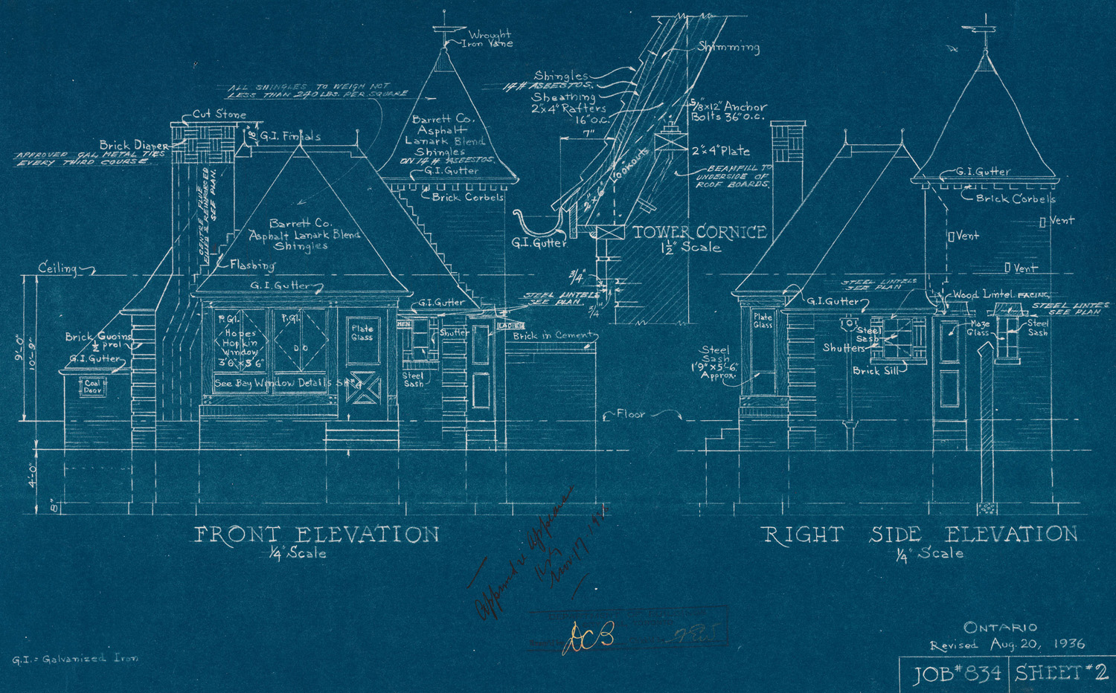
Design patterns
Notes:
Photo credit: https://en.wikipedia.org/wiki/Blueprint#/media/File:Joy_Oil_gas_station_blueprints.jpg

Slide 11
Give control
Ensure people are in control - people should be able to access and interact with content in their preferred way

Slide 12

Scroll control
Notes:
'Infinite scrolling' can be problematic, especially for users navigating by keyboard because they can't get past the stream of refreshing
content. Give the option to turn off this feature and replace it with a 'load more' button.
Photo credit: https://mindmatters.ai/2021/01/the-infinity-mirror-trap-part-2-the-thought-determinism-paradox/

Slide 13
Offer choice
Consider providing different ways for people to complete tasks, especially those that are complex or non standard

Slide 14
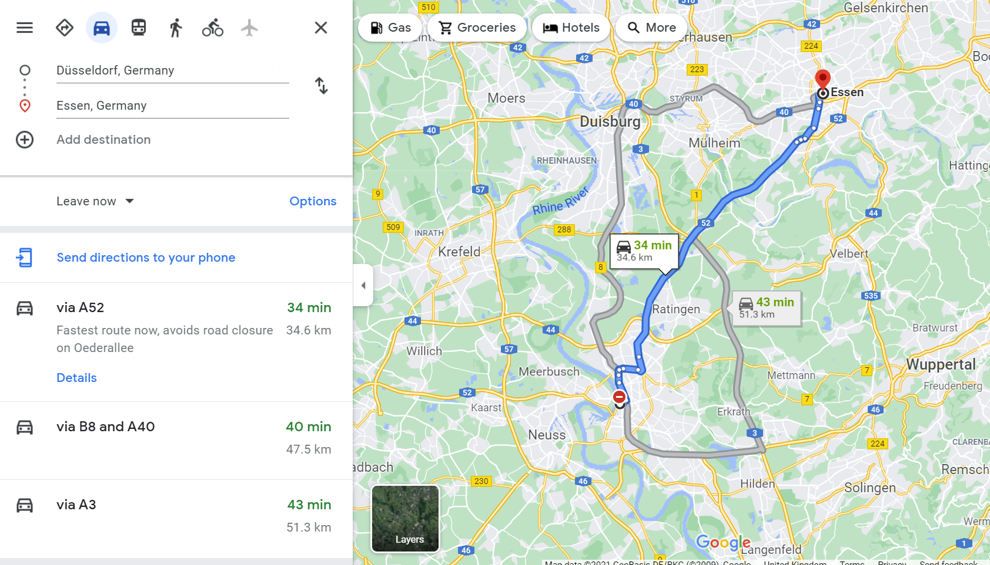
Multiple ways

Slide 15
Prioritise content
Help users focus on core tasks, features, and information by prioritising them within the content and layout

Slide 16
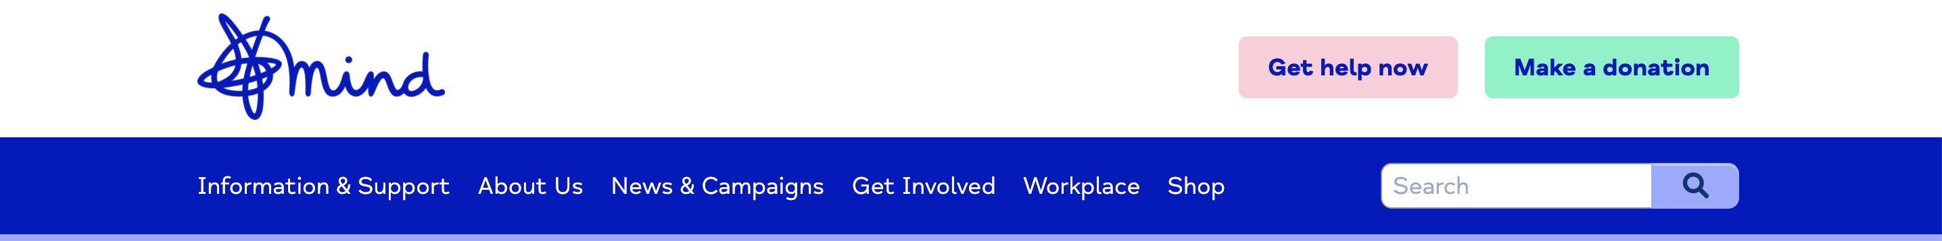
One thing at a time

Slide 17
Add value
Consider the value of features and how they improve the experience for different users

Slide 18

Do the hard work
Notes:
Photo credit: Ralf Geithe/Shutterstock

Slide 19
Thank you
DCDC @LeonieWatson

